Slide 1
GENERAL PIPELINE

Slide 2
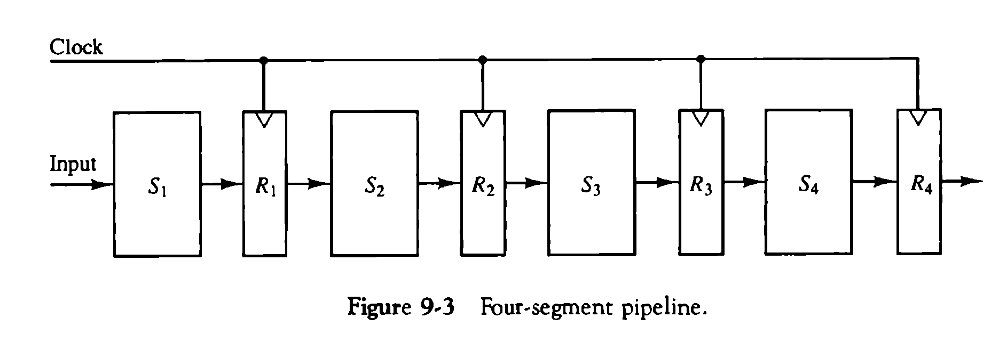
GENERAL PIPELINE
Any operation that can be decomposed into a sequence of sub operations of about the same complexity can be implemented by a pipeline processor.
The technique is efficient for those applications that need to repeat the same task many times with different sets of a task as the total operation performed going through all the segments in the pipeline.
Based on M. Morris Mano “Computer System Architecture”--Assist. Lecturer Ahmed Salah Hameed

Slide 3
SPEED CALCULATION
K-segment pipeline with a clock cycle time (tp) is used to execute n tasks.
The first task T1 requires a time equal to (k*tp) to complete its operation because we have k segments in the pipe.
The remaining n - 1 tasks emerge from the pipe at the rate of one task per clock cycle and they will be completed after a time equal to (n - 1)*tp.
Therefore, to complete n tasks using a k-segment pipeline:
k + (n - 1) clock cycles
For example system with four segments and six tasks.
The time required to complete all the operations is/
4 + (6 - 1) = 9 clock cycles
Based on M. Morris Mano “Computer System Architecture”--Assist. Lecturer Ahmed Salah Hameed

Slide 4
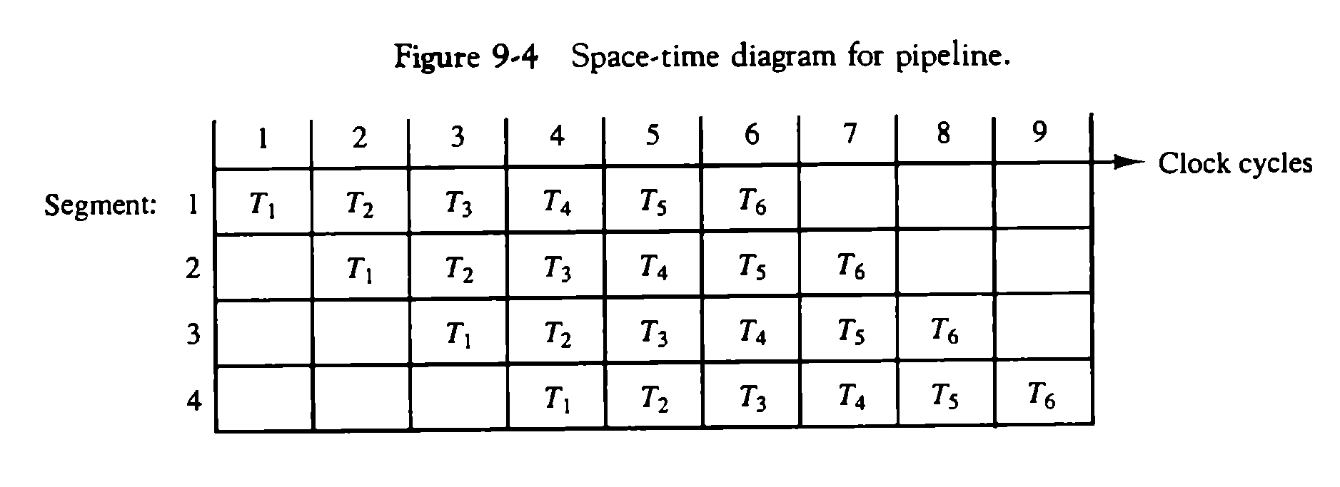
SPEED CALCULATION
Based on M. Morris Mano “Computer System Architecture”--Assist. Lecturer Ahmed Salah Hameed

Slide 5
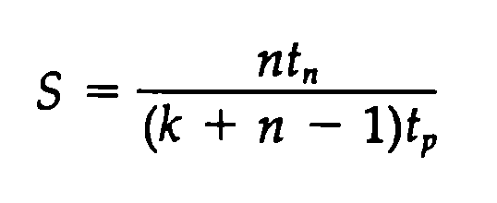
SPEED CALCULATION
NONPIPELINE UNIT
Each task take time equal to tn.
The total time required for n tasks is
n * tn
PIPELINE UNIT
To complete n tasks using a k-segment pipeline:
k + (n - 1) clock cycles
Total time is: k + (n - 1) * tp
SPEED UP
Based on M. Morris Mano “Computer System Architecture”--Assist. Lecturer Ahmed Salah Hameed

Slide 6
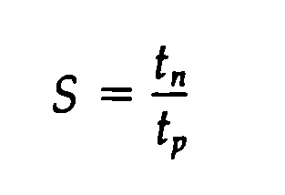
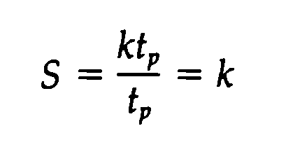
SPEED CALCULATION
NOTES
As the number of tasks increases, n becomes much larger than k - 1, and k + n - 1 approaches the value of n. Under this condition, the speedup becomes:
If we assume that the time it takes to process a task is the same in the pipeline and nonpipeline circuits, we will have tn = k*tp. So the speedup reduces to:
Based on M. Morris Mano “Computer System Architecture”--Assist. Lecturer Ahmed Salah Hameed

Slide 7
EXAMPLE ON SPEED CALCULATION
Based on M. Morris Mano “Computer System Architecture”--Assist. Lecturer Ahmed Salah Hameed

Slide 8
ARITHMETIC PIPELINE
Pipeline arithmetic units are usually found in very high speed computers. They are used to implement floating-point operations, multiplication of fixed-point numbers, and similar computations encountered in scientific problems.
EXAPLE:
FLOATING POINT ADDER
Based on M. Morris Mano “Computer System Architecture”--Assist. Lecturer Ahmed Salah Hameed

Slide 9
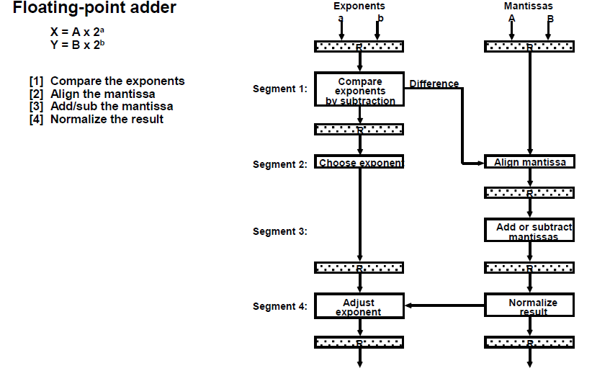
ARITHMETIC PIPELINE
Based on M. Morris Mano “Computer System Architecture”--Assist. Lecturer Ahmed Salah Hameed

Slide 10
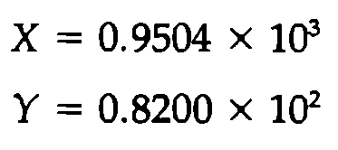
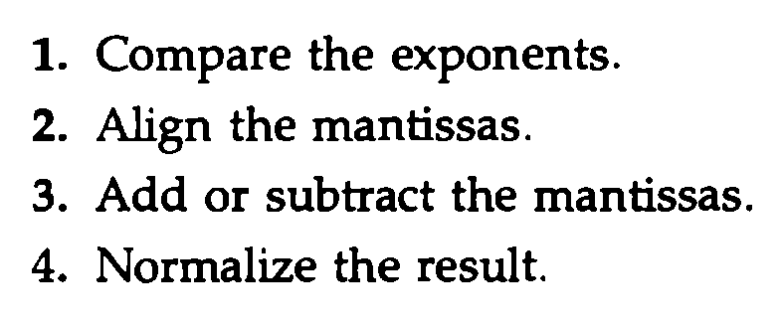
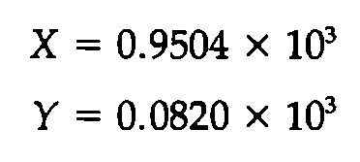
ARITHMETIC PIPELINE
Based on M. Morris Mano “Computer System Architecture”--Assist. Lecturer Ahmed Salah Hameed

Slide 11
ARITHMETIC PIPELINE EXAMPLE
Suppose that the time delays of the four segments are as following:
t1 = 60 ns
t2 = 70 ns
t3 = 100 ns
t4 = 80 ns
the interface registers have a delay of tr = 10 ns.
Pipeline
The clock cycle is chosen to be:
tp = t3 + tr = 110 ns.
Non Pipeline
Delay time tn = t1 + t2 + t3 + t4 + tr = 320 ns.
Speed up
the pipelined adder has a speedup of 320/110 = 2.9 over the non pipelined adder.
Based on M. Morris Mano “Computer System Architecture”--Assist. Lecturer Ahmed Salah Hameed

Slide 12
INSTRUCTION PIPELINE
An instruction pipeline reads consecutive instructions from memory while previous instructions are being executed in other segments. This causes the instruction fetch and execute phases to overlap and perform simultaneous operations.
Simple Example:
Consider a computer with an instruction fetch unit and an instruction execution unit designed to provide a two-segment pipeline.
2-segment pipelined Non pipelined
1 | 2 | 3 | 4
F | E
 | F | E
 |  | F | E
1 | 2 | 3 | 4 | 5 | 6
F | E
 |  | F | E
 |  |  |  | F | E
Based on M. Morris Mano “Computer System Architecture”--Assist. Lecturer Ahmed Salah Hameed

Slide 13
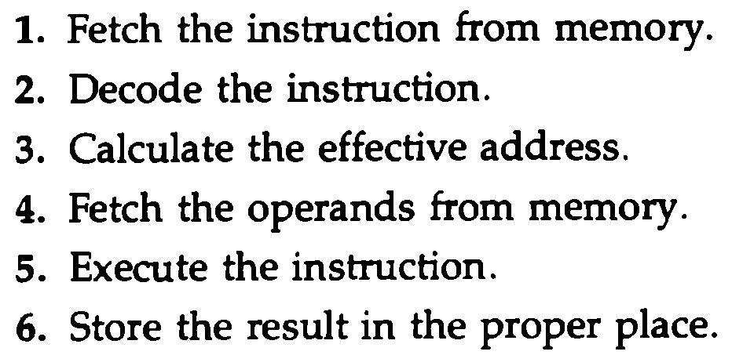
INSTRUCTION PIPELINE
NOTE 1: Computers with complex instructions require other phases in addition to the fetch and execute to process an instruction completely.
NOTE 2: Difficulties that will prevent the instruction pipeline from operating at its maximum rate.
Different segments may take different times to operate on the incoming information.
Some segments are skipped for certain operations. For example, a register mode instruction does not need an effective address calculation.
Two or more segments may require memory access at the same time, causing one segment to wait until another is finished with the memory.
Based on M. Morris Mano “Computer System Architecture”--Assist. Lecturer Ahmed Salah Hameed

Slide 14
INSTRUCTION PIPELINE
NOTE 3: Memory access conflicts are sometimes resolved by using two memory buses for accessing instructions and data in separate modules. In this way, an instruction word and a data word can be read simultaneously from two different modules.
NOTE 4: The design of an instruction pipeline will be most efficient if the instruction cycle is divided into segments of equal duration. The time that each step takes to fulfill its function depends on the instruction and the way it is executed.
Based on M. Morris Mano “Computer System Architecture”--Assist. Lecturer Ahmed Salah Hameed

Slide 15
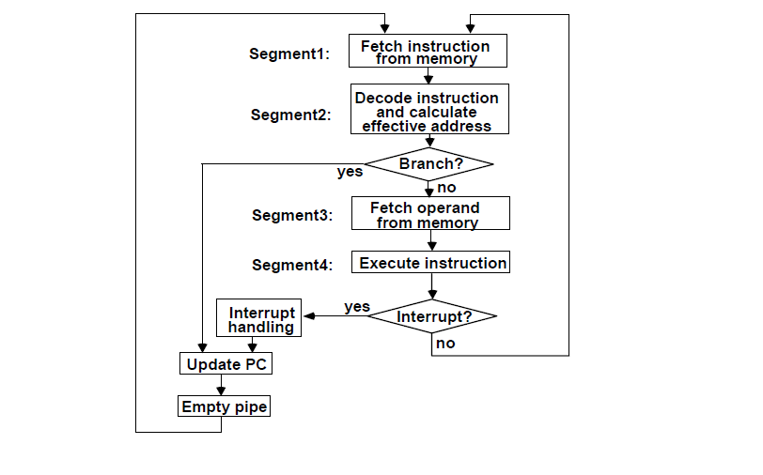
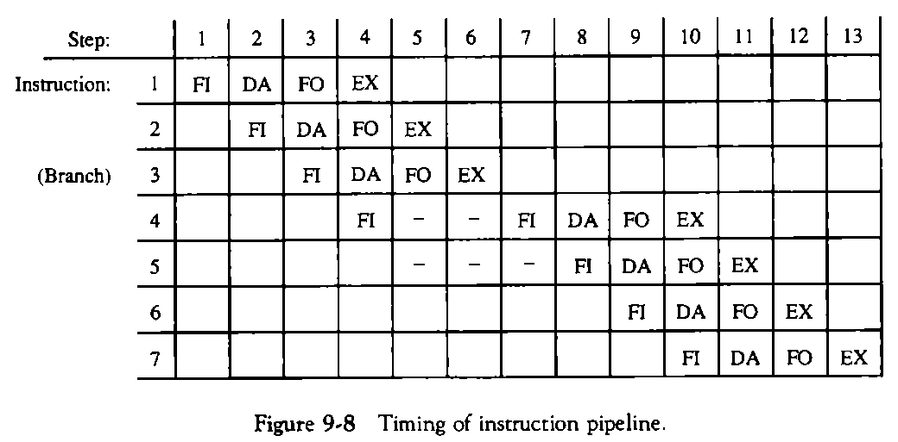
EXAMPLE: FOUR-SEGMENT INSTRUCTION PIPELINE
1. FI is the segment that fetches an instruction.
2. DA is the segment that decodes the instruction and calculates the effective address.
3. FO is the segment that fetches the operand.
4. EX is the segment that executes the instruction.
Based on M. Morris Mano “Computer System Architecture”--Assist. Lecturer Ahmed Salah Hameed

